Slide 1
DIGITAL TRANSFORMATION LEVERAGE FINANCIAL SERVICES

Slide 2
More Consumers Turn to the Digital Channel
Approximately half of the 2016 $3.9 trillion bill-pay market – housing, utilities, taxes, insurance, loans, etc. – were transacted digitally and Business Insider Intelligence forecasts it will increase to more than 75% by 2022.
Unfortunately, banks are not making the investments in technology to maximize their share of this market, as many younger adults, specifically, are choosing third-party payers, because they don’t think banks’ systems are secure or convenient.
Chatbots are one of the technologies that could benefit banks and their customers, as more than two-thirds of customers 18–70 years of age would use a chatbot after hours instead of visiting a bank branch the next day.

Slide 3
FINTECH IN OMAN
young, tech savvy population” with high telecom and internet penetration rates
01
131% mobile use
02
104% Mobile Broadband access per inhabitant
03
75% Fixed broadband access per household

Slide 4
Evolution of Digital Innovation in Financial Services
Bank 4.0
2017+
2020
Bank 2.0
1980s - 2007
Bank 1.0
1472 - 1980s
Bank 3.0
2007 - 2017

Slide 5
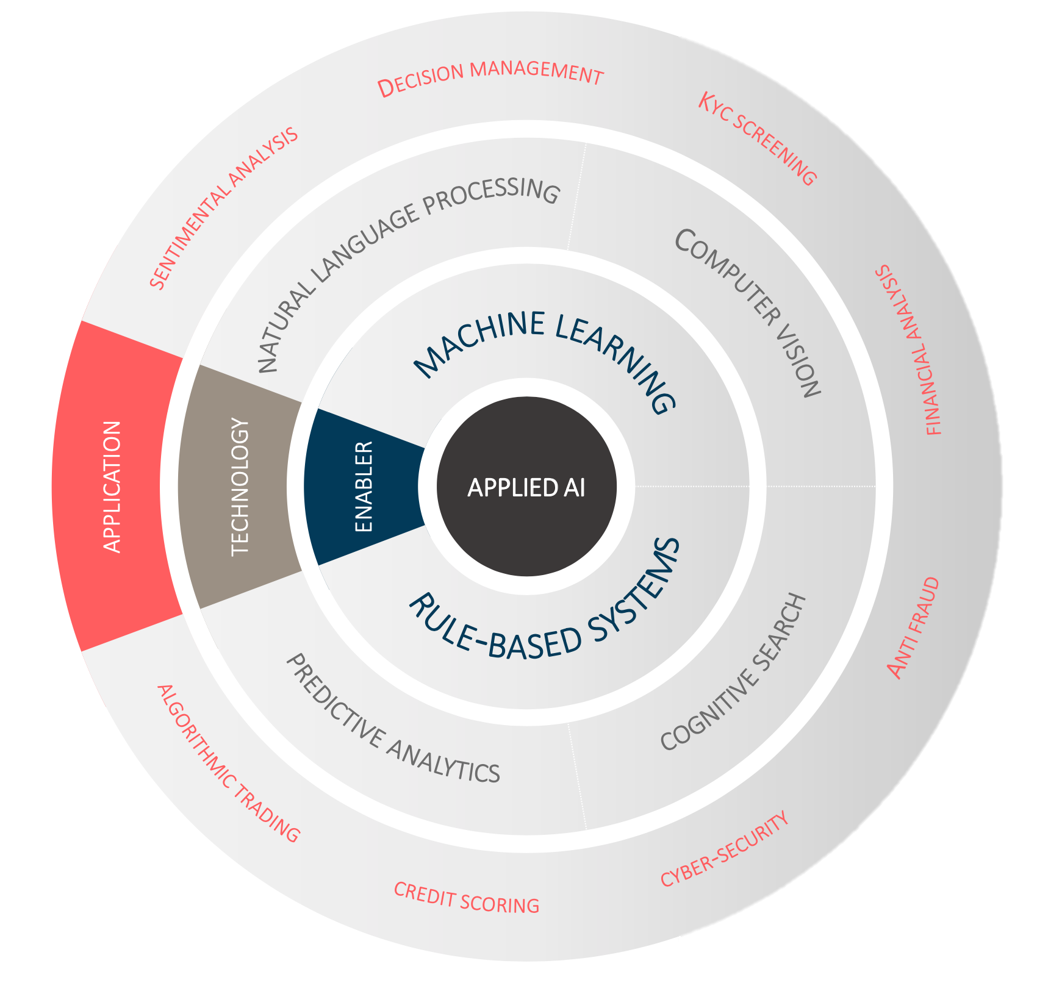
Artificial Intelligence and Financial Services
Artificial intelligence is a set of technologies able to perform tasks normally requiring human intelligence.
Tasks like visual perception, speech recognition, decision-making, translation between languages.
AI software can handle huge amounts of unstructured and structured data and automate processes.
This reduces manual tasks and provides game changing business intelligence.

Slide 6
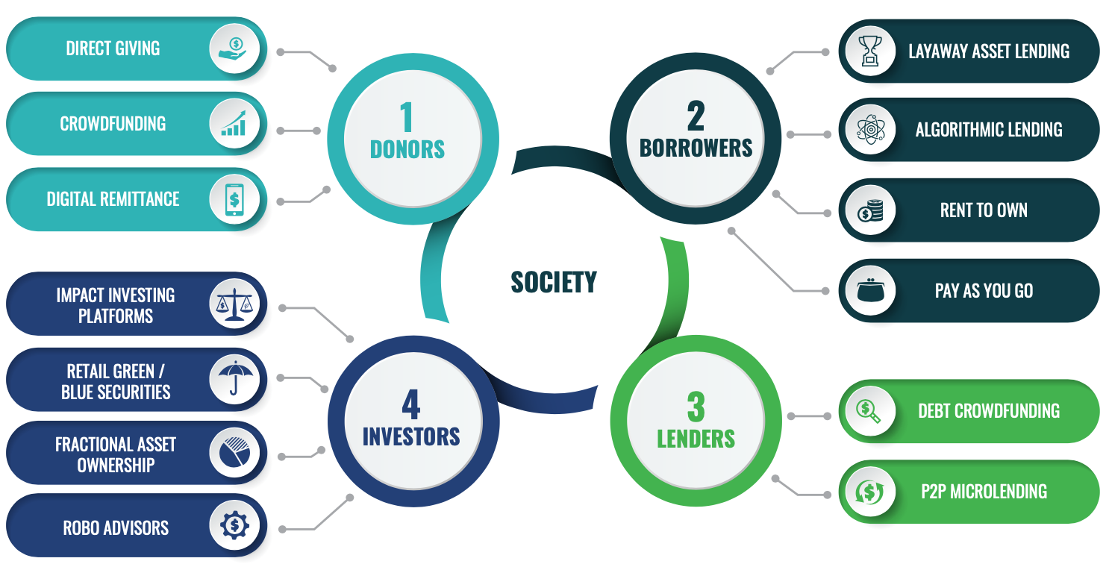
Artificial Intelligence and Finance

Slide 7
AI Enablers, Foundational Technologies & Applications
EQUITY-BASED CONTRACTS
Artificial Intelligence
Natural Language
(NL)
Machine Learning
(ML)
Processing
(NLP)
Generation
(NLG)
Predictive Analytics
(Capital/Investment)
Sharkah Al-Amal
(Labour/Service)
Sharkah
Al-Wujuh
(Goodwill/Credit)
Sharkah
Al-Mudarabah
(Profit Sharing)
Risk Modelling
(Capital)
Biometrics
(General)
Fraud Detectn
(General)
Underwriting
(General)

Slide 8
Risk Assessment in Financial Services
Credit scoring ( bank as lender, borrower, payment provider )
A
A
E
A
E
C
B
D
B
E
C
E
C
C
D
C
A
A
D
E
E
D
D
E
E
A
B
B
A
D
Hardly no lending possible without collateral until
the 1990s as granting a loan to a possible defaulter
(false-positive) is costlier than not granting a credit
to otherwise good borrowers
A
B
C
D
E

Slide 9
Artificial Intelligence
The Application of artificial intelligence using the alternative data may enable developing more accurate
algorithms to assess creditworthiness, predict failure, and develop tailored pricing and products/
services
Identify
Advertise
How many likes
How many tweets
How many following
How many subscriptions

Slide 11
Thank You

